Slide 1
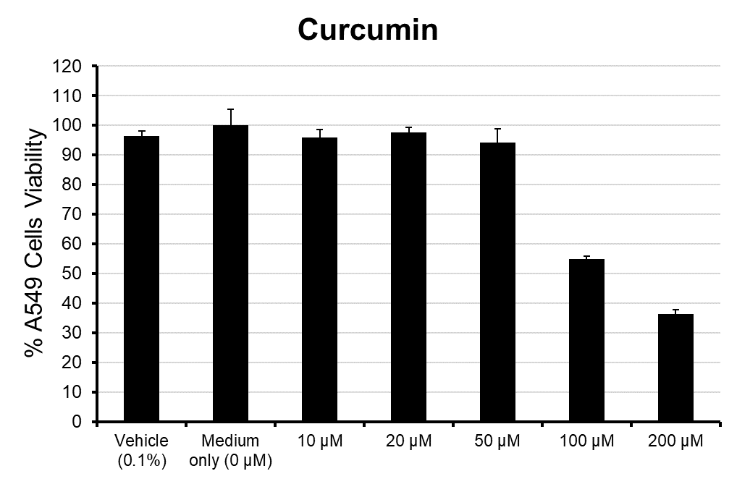
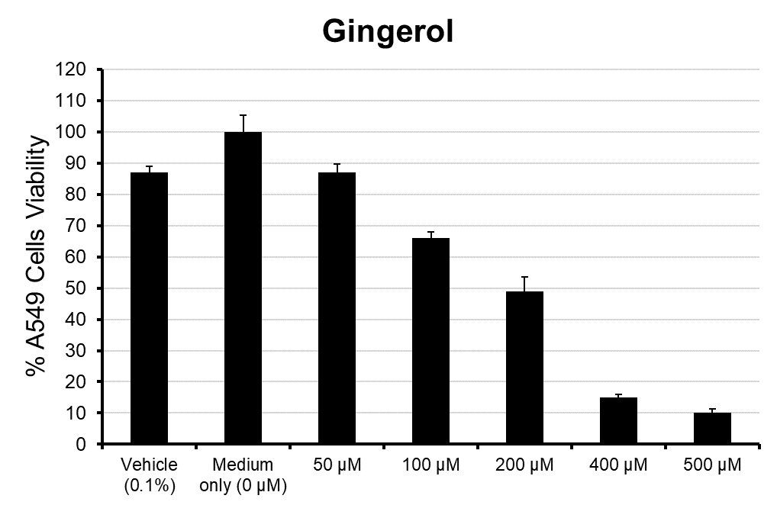
Figure 1
A
R² = 0.9132
p = 0.0029 (ANOVA)
CC₅₀ = 108 μM
B
R² = 0.9149
p = 0.0001 (ANOVA)
CC₅₀ = 210 μM

Slide 2
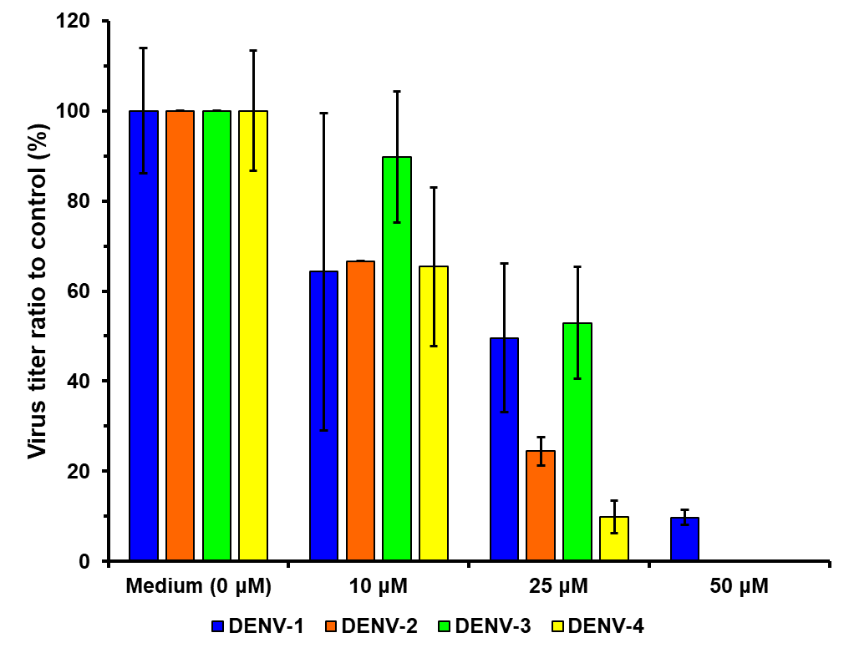
Figure 2
Curcumin
**
**
**
**
**
**
ns
ns
*
**
**
**

Slide 3
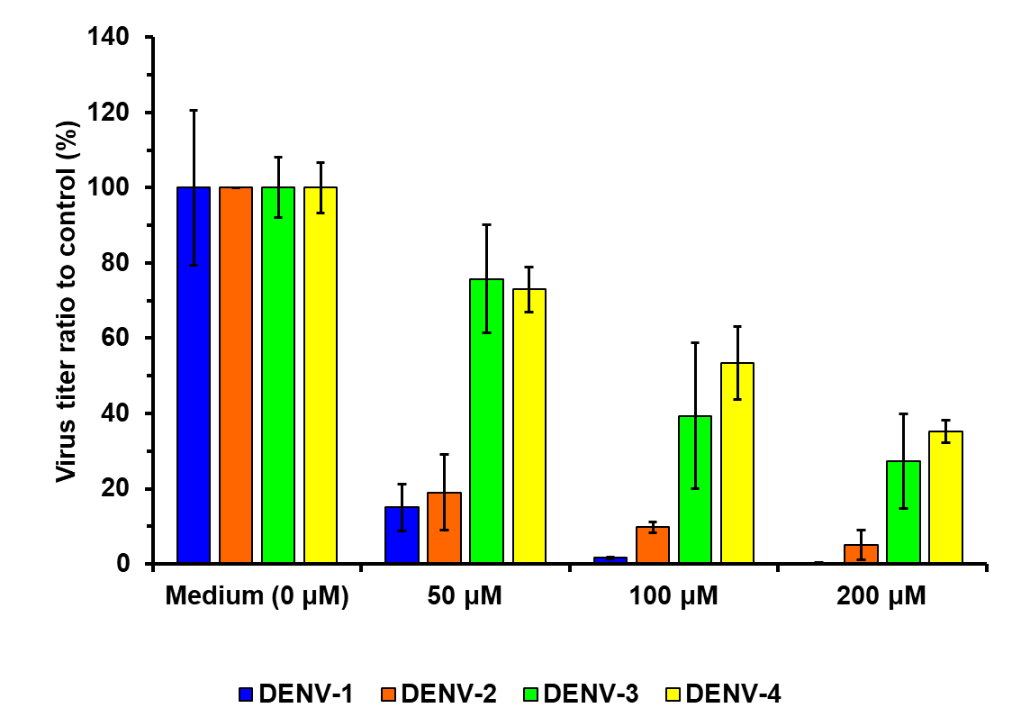
Figure 3
6-Gingerol
*
*
*
*
*
*
*
*
*
ns
*
*

